Slide 1
Customer SUPPORT Group
STAFFING STRATEGY

Slide 2
Current System
The Customer Support team currently works two 7-hour shifts during the day:
8:00 AM – 3:00 PM
3:00 PM – 10:00 PM
This is a problem because inbound volume highly varies throughout those 7-hour periods.
We have to staff the entire shift to be able to support peak volume, even if that volume only lasts for a fraction of the shift.
This is inefficient and increases operating costs.

Slide 3
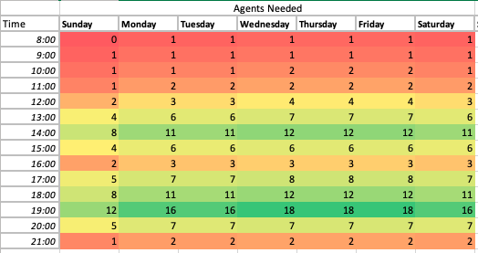
Current Volume
This heat chart shows the number of agents needed per hour to support the inbound volume.
For the 8:00 AM – 3:00 PM shift, we have to staff 8-12 people, even though only 1-2 are needed for the first half of the shift (8:00 AM – 12:00 PM).
A similar trend is seen in the 3:00 PM – 10:00 PM shift, where the peak is around 6:00 PM – 8:00 PM.
This schedule system results in a weekly cost of $16,844.00.

Slide 4
Learnings
Based on the heat chart above, we conclude the following:
Volume can be broken down into blocks of a few hours where inbound volume per hour is relatively consistent.
On any given day, there are two peak times, one around 2:00 PM and another at 7:00 PM.
Some days have the exact same hourly profile in terms of agents needed to service the demand i.e. Monday, Tuesday, Saturday share the same profile.

Slide 5
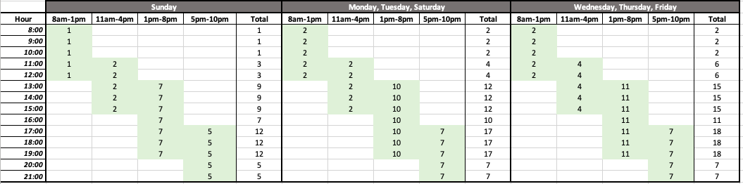
Staggered scheduling
With the new ability to schedule shifts of different lengths (4+ hours), we can use staggered, overlapping shifts to more efficiently service inbound volume and reduced costs.
Using the heat chart, we’ve designed a schedule of four shifts to reduce costs while still meeting customer expectations.
The new schedule brings operating cost down to $10,680.00. That’s a 37% reduction in labor costs.

